Slide 1

Welcome to our Webinar
Your speaker is: Alice Stagg
Chaired by: Yvonne Onomor
www.citma.org.uk

Slide 2
A question of geography: 12 months of european trade mark judgments
Alice stagg

Slide 3
“Next week, it will be three months
after the sending of the Article 50 letter
… I can’t negotiate with myself.”
Michel Barnier, 12 June 2017

Slide 4
12 months of european trade mark judgments: in numbers

Slide 5
12 months of european trade mark judgments: in numbers
Period: 1 June 2017 – 31 May 2018
158 GC and CJEU decisions involving trade marks
  18 judgments – CJEU
  140 judgments – General Court

Slide 6
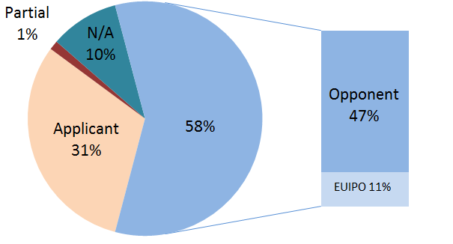
Who is more likely to win?

Slide 7
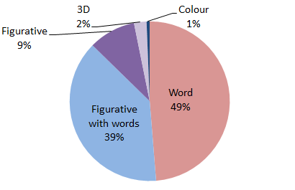
What Types of mark are involved?

Slide 8
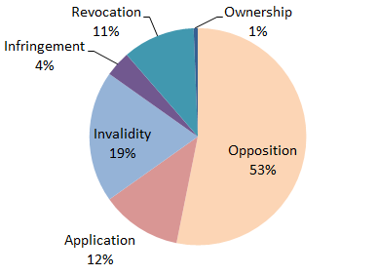
What causes of action are involved?

Slide 9
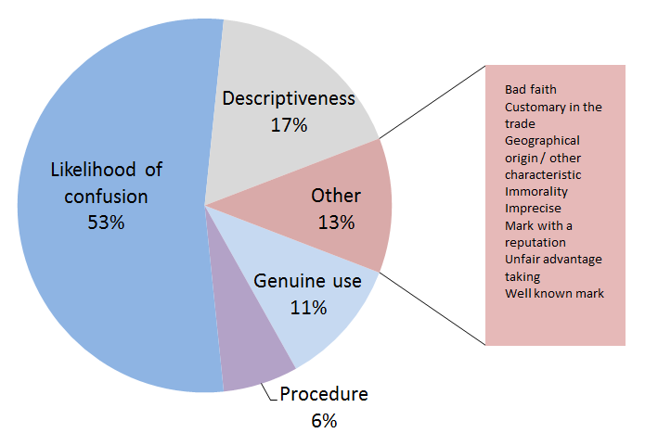
What issues are involved?

Slide 10
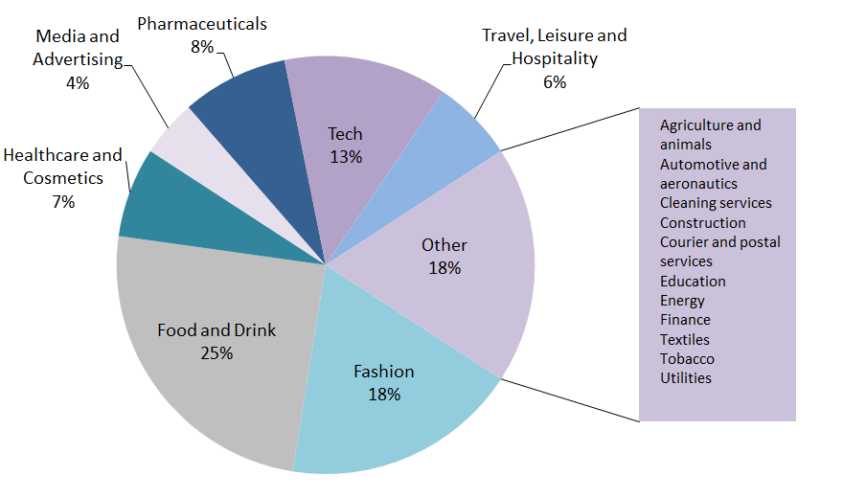
What sectors are involved?

Slide 11
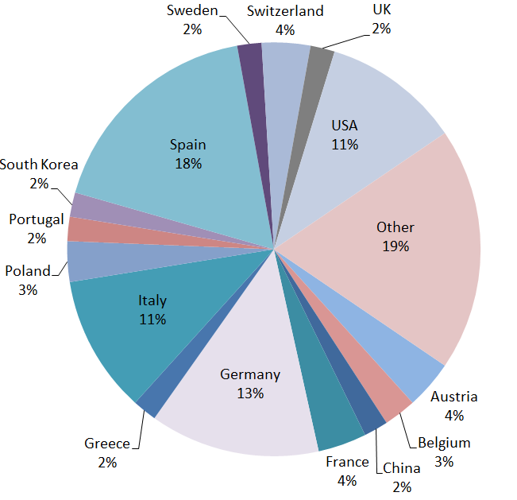
Where are the applicants located?

Slide 12
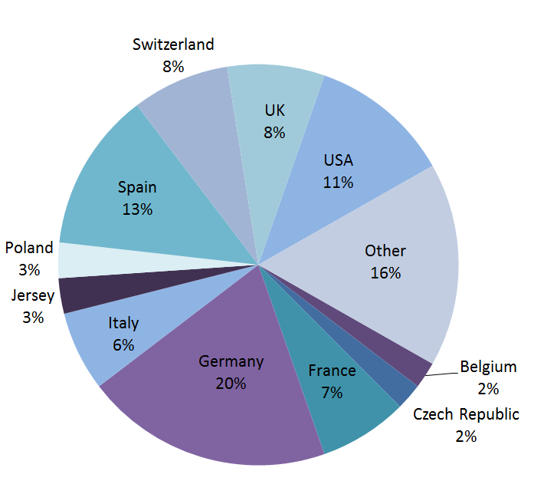
Where are the opponents located?

Slide 13
Chances of success as an applicant
No successful appeals against the EUIPO this year
  Out of 19 judgments
Much better chance against opponent
  But still more likely to lose than win
  49 appeals won by applicant vs 74 won by opponent

Slide 14
Absolute grounds for refusal

Slide 15
GEOGRAPHICAL ORIGIN – ‘THE GOLDEN MILE’
Juan Marin and others v Abadia Retuerta SA (Case C-139/16)
LA MILLA DE ORO
Class 33 for Wine
Held:
  No connection between wine and the geographical origin attributed to ‘La Milla de Oro’ alone
  A characteristic of a product / service that could be found “in abundance in a single place with a high degree of value”

Slide 16
Geographical origin – port charlotte
EUIPO v Instituto dos Vinhos do Douro e do PortoIP (Bruichladdich Distillery and others intervening) (Case C-56/16)
PORT CHARLOTTE
Class 33 for Whisky
Held: No geographical reference to Port wine

Slide 17

Geographical origin - darjeeling
The Tea Board v EUIPO (Delta Lingerie intervening) (Case C-673/15 to C-676/15)
Classes 25, 35 and 38 including Lingerie
Opposed on the basis of an EU collective mark for DARJEELING in Class 30 for Tea
Held: Upheld GC’s finding that a consumer of tea would not be led to believe Delta Lingerie’s lingerie originated from the Darjeeling region of India

Slide 18
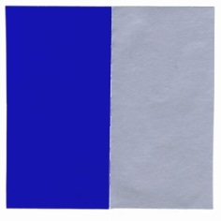
Red bull colour mark
Red Bull GmbH v EUIPO (Optimum Mark and MARQUES intervening) (Joined Cases T-101/15 and T-102/15)
First application:
  ‘Protection is claimed for the colours blue (RAL 5002) and silver (RAL 9006). The ratio of the colours is approximately 50%-50%’.
Second application:
  Indication of colours: ‘Blue (Pantone 2747C), silver (Pantone 877C)’
  Description: ‘The two colours will be applied in equal proportion and juxtaposed to each other’.
In Class 32 for ‘Energy Drinks’
Held: Insufficiently precise
Appeal pending before the CJEU (Case C-124/18)

Slide 19

Pirelli tyre
Pirelli Tyre SpA v EUIPO (Case T-81/16)
Description: ‘A pair of essentially equal curved strips positioned on the side of a tyre and running along its circumference. The trade mark in question is a position mark.’
Class 12 for ‘Tyres, solid, semi-pneumatic and pneumatic tyres, rims and covers for vehicle wheels’
Held: Devoid of distinctive character

Slide 20
Descriptiveness – bet365
Bet365 Group Ltd v EUIPO (Robert Hansen intervening) (Case T-304/16)
BET 365
  Including in Class 41 for Betting and gambling services
BoA: no acquired distinctiveness
GC:
  Relevant territory – EU Member States in which a large part of consumers spoke or understood English
  Denmark, Ireland, the Netherlands, Finland, Sweden and the UK
  Cyprus and Malta should also have been taken into account
Held:
  Use of the mark as the name of a website could constitute use as a TM
  Applicant had demonstrated acquired distinctiveness
Appeal pending before the CJEU (Case C-136/18)

Slide 21
Descriptiveness – love to lounge
Lidl Stiftung & Co KG v EUIPO (Primark Holdings intervening) (Case T-305/16)
LOVE TO LOUNGE
Class 25 for Clothing, footwear and headgear
Held:
  A vague and evocative message alluding to a particular interest or pleasure in relaxing
  Does not designate an easily recognisable property of the contested goods
  Not purely laudatory
  Not devoid of distinctive character

Slide 22
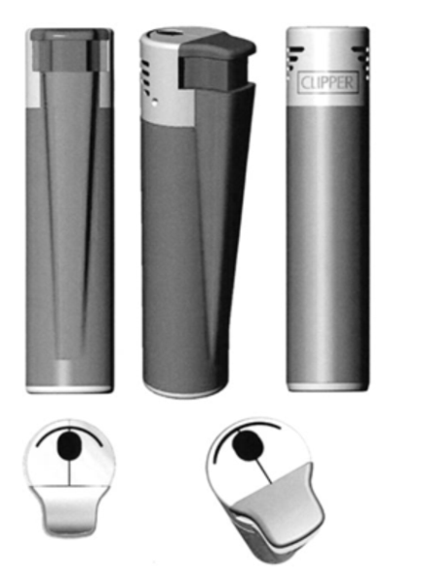
Flamagas cigarette lighter
Flamagas SA v EUIPO (MatMind Srl intervening) (Case T-580/15)
Class 4 for ‘Fuel gas, compressed’ and Class 34 ‘Lighters for smokers’, amongst others
Art 7(1)(e)(ii), Regulation: “signs which consist exclusively of… the shape of goods which is necessary to obtain a technical result [shall not be registered]”
Held: sign that consists exclusively of the shape of a product

Slide 23

novartis transdermal patch
Novartis AG v EUIPO (SK Chemicals GmbH) (Case T-44/16)
Class 5 for ‘Pharmaceutical preparations for the treatment of dementia of the Alzheimer’s type’
Held: sign that consists exclusively of the shape of a product

Slide 24

Contrary to public policy
La Mafia Franchises SL v EUIPO (Italian Republic intervening) (Case T-1/12)
Classes 25, 35 and 43 including Services for providing food and drink, bars, cafeterias, cafes
Held: contrary to public policy

Slide 25
LIKELIHOOD OF CONFUSION

Slide 26

Cantina e oleificio sociale di san marzano v euipo (miguel torres sa intervening) (case t-102/17)
Cantina e oleficio sociale di San Marzano
(Applicant)
Miguel Torres
(Opponent)
Class 33: Alcoholic beverages (except beers)
SANGRE DE TORO
EU and Spanish marks
Class 33: Alcoholic beverages (except beers)

Slide 27
Cantina e oleificio sociale di san marzano v euipo (miguel torres sa intervening) (case t-102/17)
Cantina e oleficio sociale di San Marzano
(Applicant)
Miguel Torres
(Opponent)
Class 33: Alcoholic beverages (except beers)
SANGRE DE TORO
EU and Spanish marks
Class 33: Alcoholic beverages (except beers)
Held: Likelihood of confusion

Slide 28


Kiosked oy ab v euipo (de vlaamse radio – en televisieomroeporganisatie (vrt)) (case t-824/16)
Kiosked Oy Ab
(Applicant)
VRT
(Opponent)
Class 35: Advertising
Class 42: Design and development of computer hardware and software
Benelux mark
Class 35: Advertising
Class 42: Designs and development for software for multimedia applications

Slide 29
Kiosked oy ab v euipo (de vlaamse radio – en televisieomroeporganisatie (vrt)) (case t-824/16)
Kiosked Oy Ab
(Applicant)
VRT
(Opponent)
Class 35: Advertising
Class 42: Design and development of computer hardware and software
Benelux mark
Class 35: Advertising
Class 42: Designs and development for software for multimedia applications
Held: Likelihood of confusion

Slide 30
Tulliallan burlington ltd v euipo (burlington fashion gmbh) (case t-123/16)
Burlington Fashion GmbH
(Applicant)
Tulliallan Burlington Ltd
(Opponent)
BURLINGTON
Class 25: Footwear, clothing, headgear
BURLINGTON
UK mark
Class 35: The bringing together, for the benefit of others, a variety of goods, enabling customers to conveniently view and purchase those goods from general merchandise retail stores

Slide 31
Tulliallan burlington ltd v euipo (burlington fashion gmbh) (case t-123/16)
Burlington Fashion GmbH
(Applicant)
Tulliallan Burlington Ltd
(Opponent)
BURLINGTON
Class 25: Footwear, clothing, headgear
BURLINGTON
UK mark
Class 35: The bringing together, for the benefit of others, a variety of goods, enabling customers to conveniently view and purchase those goods from general merchandise retail stores
Held: different goods/services
No likelihood of confusion

Slide 32

Convivo gmbh v euipo (porcesadora nacional de alimentos ca pronaca intervening) (case t-288/16)
Convivo GmbH
(Applicant)
Porcesadora Nacional de Alimentos CA Pronaca
(Applicant)
M’COOKY
Class 43: Services for providing food and drink
Spanish mark
Class 30: Coffee, tea, cocoa, sugar, rice, tapioca, sago, artificial coffee; flours and preparations made from cereals; bread, pastry, and confectionery, ices; honey, treacle; yeast, baking powder; salt, mustard; vinegar, sauces (except salad dressings); spices, ice;

Slide 33
Convivo gmbh v euipo (porcesadora nacional de alimentos ca pronaca intervening) (case t-288/16)
Convivo GmbH
(Applicant)
Porcesadora Nacional de Alimentos CA Pronaca
(Applicant)
M’COOKY
Class 43: Services for providing food and drink
Spanish mark
Class 30: Coffee, tea, cocoa, sugar, rice, tapioca, sago, artificial coffee; flours and preparations made from cereals; bread, pastry, and confectionery, ices; honey, treacle; yeast, baking powder; salt, mustard; vinegar, sauces (except salad dressings); spices, ice;
Held: Likelihood of confusion

Slide 34

Deutsche post ag v euipo (bpost nv intervening) (case t-118/16)
bpost NV
(Applicant)
Deutsche Post AG
(Opponent)
BEPOST
Class 39: Mail delivery; Transport and delivery of postal items and parcels
EU mark
POST
German mark
Class 39: Postal, freight and courier services; Collection, transport and delivery of goods, in particular documents, packages, parcels, letters and pallets

Slide 35
Deutsche post ag v euipo (bpost nv intervening) (case t-118/16)
bpost NV
(Applicant)
Deutsche Post AG
(Opponent)
BEPOST
Class 39: Mail delivery; Transport and delivery of postal items and parcels
EU mark
POST
German mark
Class 39: Postal, freight and courier services; Collection, transport and delivery of goods, in particular documents, packages, parcels, letters and pallets
Held: no likelihood of confusion

Slide 36
Unfair advantage taking

Slide 37
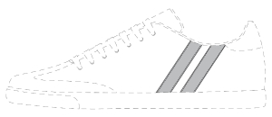
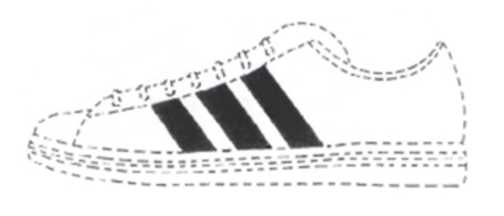
Shoe Branding Europe BVBA v EUIPO (adidas AG intervening) (Case T-85/16 and Case T-629/16)
Shoe Branding Europe
(Applicant)
adidas
(Opponent)
‘The trade mark is a position mark. The mark consists of two parallel lines positioned on the outside surface of the upper part of a shoe. The parallel lines run from the sole edge of a shoe and slopes backwards to the middle of the instep of a shoe. The dotted line marks the position of the trade mark and does not form part of the mark’.
Class 25 for Footwear
Class 9 for Safety footwear for the protection against accidents or injury
EU mark
‘The mark consists of three parallel equally spaced stripes applied to footwear, the stripes positioned on the footwear upper in the area between the laces and the sole’
Class 25 for Footwear

Slide 38
Shoe Branding Europe BVBA v EUIPO (adidas AG intervening) (Case T-85/16 and Case T-629/16)
Held: adidas mark enjoyed a high, long-held and enduring reputation
SBE argued coexistence of the marks at issue on the market for a great number of years
  But various prior disputes between the parties
  Held: not ‘peaceful’ coexistence
Use of ‘two stripes are enough’ slogan by SBE
Held: unfair advantage taking

Slide 39
Gall pharma gmbh v euipo (pfizer inc intervening) (case t-662/16)
Gall Pharma GmbH
(Applicant)
Pfizer Inc
(Opponent)
STYRIAGRA
Class 29 : Preserved, frozen, dried fruits and vegetables, in particular pumpkin seeds
VIAGRA
EU mark
Class 5 : Pharmaceutical and veterinary preparations and substances

Slide 40
Gall pharma gmbh v euipo (pfizer inc intervening) (case t-662/16)
Gall Pharma GmbH
(Applicant)
Pfizer Inc
(Opponent)
STYRIAGRA
Class 29 : Preserved, frozen, dried fruits and vegetables, in particular pumpkin seeds
VIAGRA
EU mark
Class 5 : Pharmaceutical and veterinary preparations and substances
Held: Unfair advantage taking

Slide 41
enforcement

Slide 42

Ornua Co-Operative v Tindale & Stanton Ltd Espana SL (Case C-93/1996)
Ornua
(Proprietor)
Tindale & Stanton
(Defendant)
KERRYGOLD
EU marks
Class 29, including for Butter and other dairy products
KERRYMAID
Used in relation to Margarine
(Registered TM in IE and UK)

Slide 43
Geographical origin – defence to infringement
Ornua bought infringement proceedings against importation / distribution by T&S of KERRYMAID margarine in Spain
Article 14 (was Article 12) of the Regulation – an EU TM shall not entitle the proprietor to prohibit a third party from using in the course of trade indications concerning the geographical origin of the goods or service provided his use is in accordance with honest practices
Held: national court should consider:
  Any significant differences between market conditions or sociocultural circumstances between
    Part of the EU covered by the infringement action; and
    Part of the EU in which the geographical area corresponds to the geographical word contained in the marks and sign
  Analysis may differ in a part of the EU where consumers have a particular affinity with the geographical word

Slide 44


Schweppes sa v red paralela sl and another (case c-291/16)
The Coca-Cola
Company
Schweppes International (was Cadbury Schweppes)
GB marks
Schweppes SA (Claimant)
S u p p l y
ES marks
Red Paralela
(Defendant)
Import?

Slide 45
Parallel importing
Evidence of Schweppes and Coca-Cola acting collaboratively
  Single global image of SCHWEPPES
  Shared benefit of EU-wide websites
  Co-ordinated marketing activities and filing strategies
  In NL, Coca-Cola = Schweppes licensee
Held: rights of an owner of a national mark in one MS may be exhausted where there is an identical mark covering the same goods in a second MS
This second mark was originally owned by the same proprietor, but is now owned by a third party
Has the owner actively and deliberately continued to promote an image of there being a single global trade mark?
Economic links between the mark owner and the third party?

Slide 46
Interpreting ip translator

Slide 47

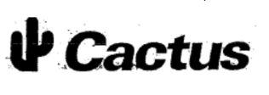
Euipo v cactus sa (isabel del rio rodriguez) (case c-501/15)
Ms Del Rio Rodriguez
(Applicant)
Cactus SA
(Opponent)
Classes 31, 39 and 44
CACTUS (reg’d on 18 Oct 2002)
(reg’d on 6 April 2001)
EU marks
Class 35, amongst others
Opposition upheld for:
  ‘Seeds, natural plants and flowers’ in Class 31
  ‘Gardening, plant nurseries, horticulture’ in Class 44
Mark registered in Class 39
Genuine use by Cactus SA proved in Class 35 for ‘Retailing of natural plants and flowers, grains; fresh fruits and vegetables’
Retail services fall within Class 35 of the Nice Agreement
But, neither ‘Retailing services’ as such nor ‘Retailing of natural plants and flowers, grains; fresh fruits and vegetables’ are included in the alphabetical list of that class

Slide 48
Interpreting ip translator
Chartered Institute of Patent Attorneys (C-307/10) (the IP Translator judgment):
  Applicant must identify the goods or services to be covered with "sufficient clarity and precision" to determine the extent of the protection sought.
  Where a class heading is used, applicant must specify whether his application is intended to cover all the goods or services listed in that class, or only some of them.
  If the application is intended to cover only some of those goods or services, these must specified.
Widely assumed that IP Translator applied retroactively
Eg. on 20 June 2012, President of EUIPO adopted Communication No 2/12 stating:
'As regards [EU marks] registered before [the effective date of this Communication], [the EUIPO] considers that the intention of the applicant … was to cover all the goods or services included in the alphabetical list of that class in the edition in force at the time when the filing was made.'

Slide 49
Interpreting ip translator
Held: the correct approach when considering class headings is to apply the rules which were in force at the date of registration of the mark.
  Followed Brandconcern BV v EUIPO and Scooters India Ltd (Case C-577/14) - February 2017
Applicable rules were summarised in Communication No 4/03 of the President of the EUIPO of 16 June 2003:
‘The 34 classes for goods and the 11 classes for services comprise the totality of all goods and services. As a consequence of this the use of all the general indications listed in the class heading of a particular class constitutes a claim to all goods or services falling within this particular class'.

Slide 50
Interpreting ip translator
Article 33(5) of new Regulation 2017/1001
  Became effective on 1 October 2017
  Cactus judgment given just after this, on 11 October, but no reference to the Article, which provides:
'The use of general terms, including the general indications of the class headings of the Nice Classification, shall be interpreted as including all the goods or services clearly covered by the literal meaning of the indication or term. The use of such terms or indications shall not be interpreted as comprising a claim to goods or services which cannot be so understood.'
Class 35 heading is ‘Advertising; business management; business administration; office functions.’

Slide 51
conclusion

Slide 52
conclusion
Less of a focus on exotic marks
Second phase of EU TM reforms took effect
1 October 2017 – entry into force of:
  New codified Regulation 2017/1001 on the European Trade Mark
  Implementing Regulation 2017/1431
  Delegated Regulation 2017/1430

Slide 53

Alice stagg
+44 203 636 7816
alice.stagg@gowlingwlg.com

