Slide 1

Welcome to our Leeds lecture
Your speaker is
Redvers Cunningham
www.citma.org.uk

Slide 2

Emerging Professional Liability Risks for IP Professionals
Redvers Cunningham
Chief Executive of PAMIA

Slide 3

How is PAMIA doing?
Assets of £28m
Claims Provisions of £10m
Regulatory Capital of £15m
Solvency Requirement of £5m

Slide 4

Claims Statistics
9000 Notifications
360 Claims
£20m Claims Payments
£3.5m Largest Loss
Only 6 Trials

Slide 5

Claims By Practice Area

Slide 6
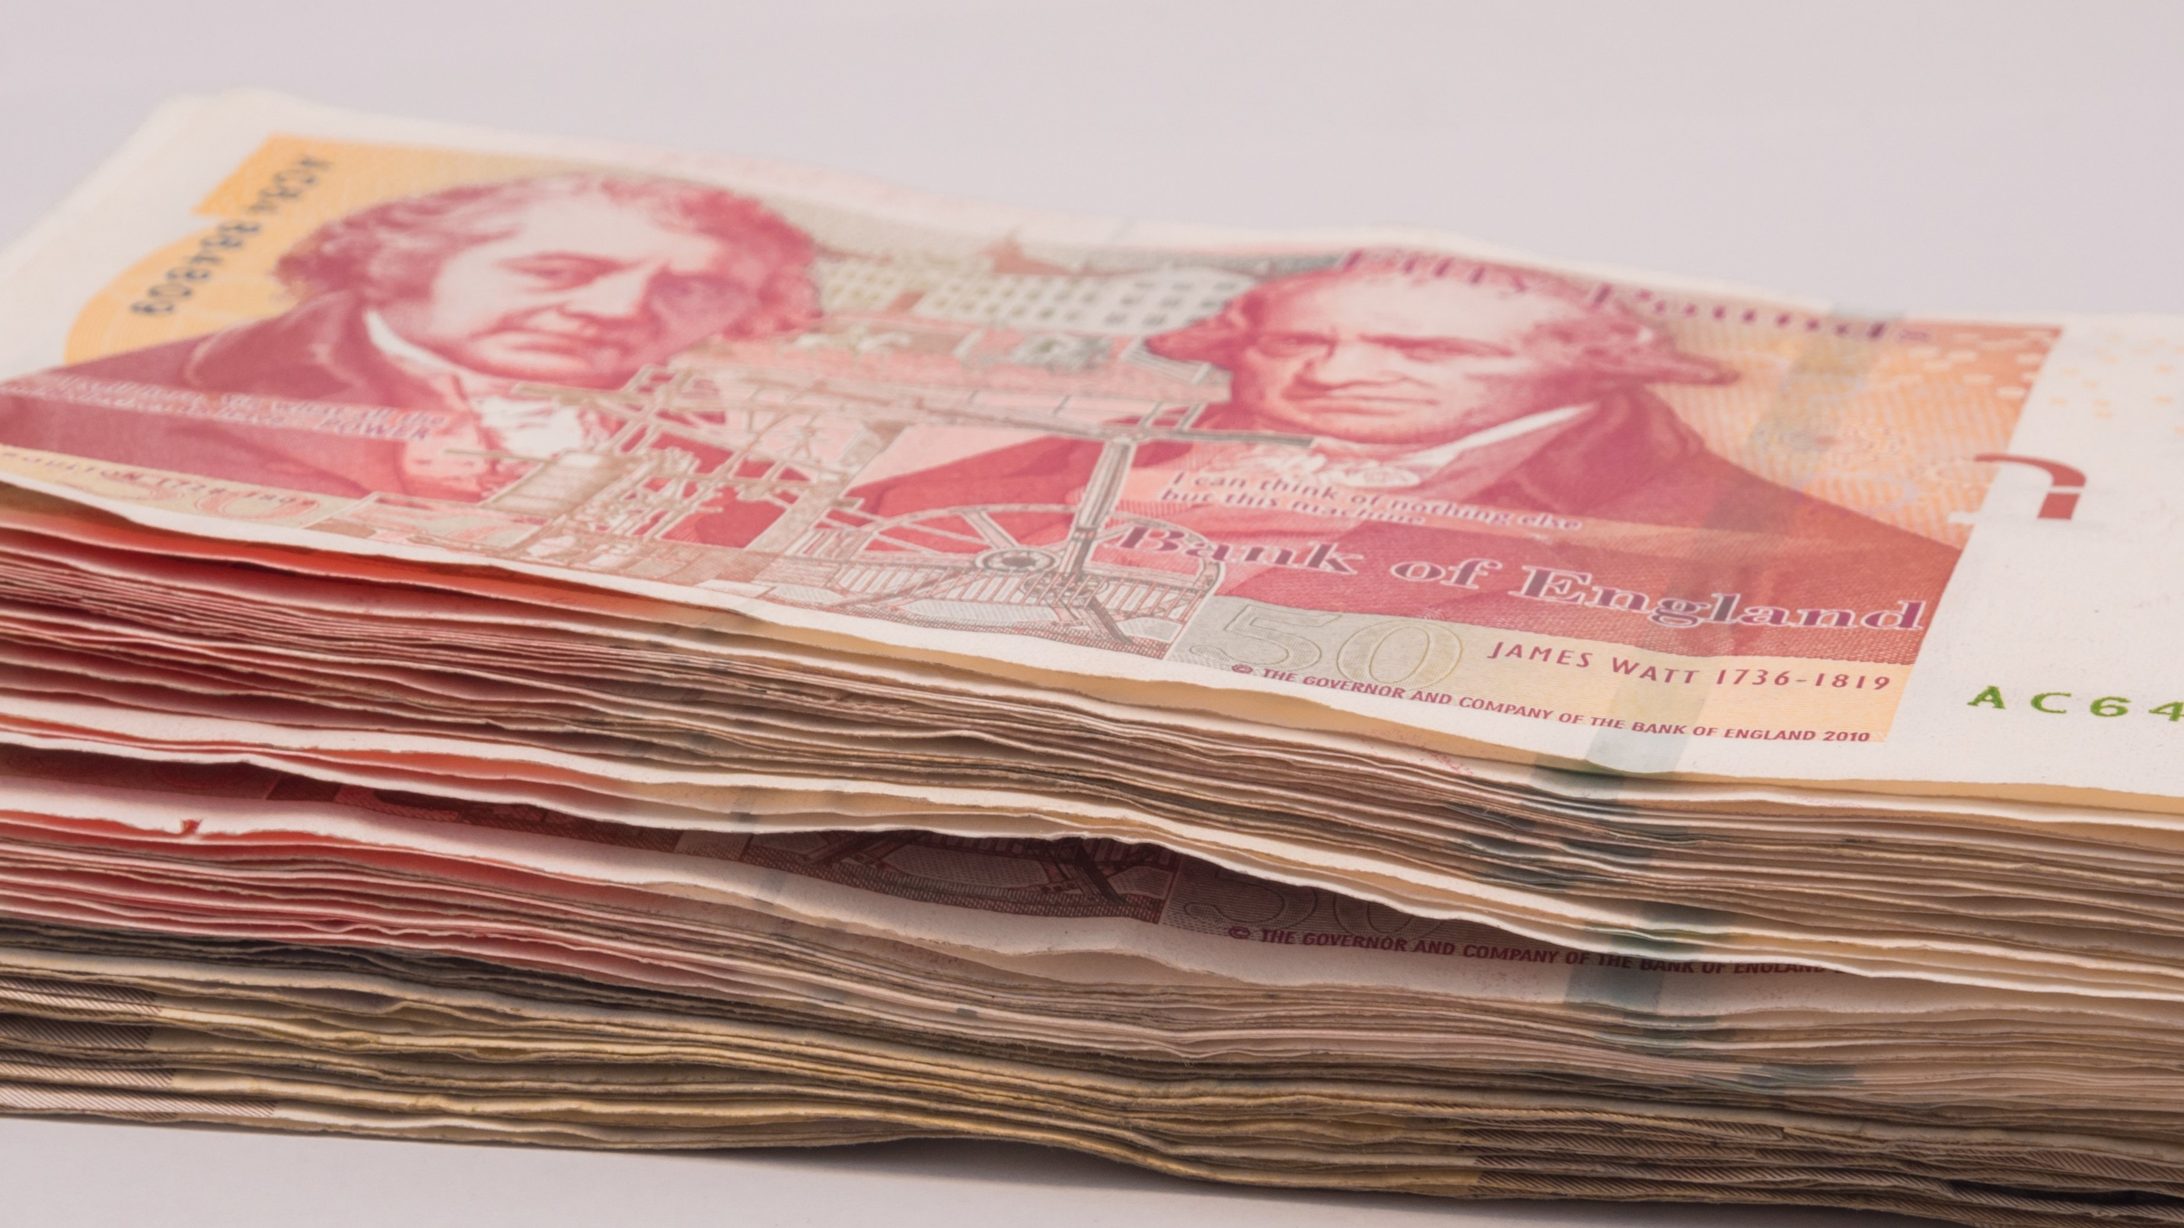
Claims By Practice Area

Slide 7

Patent Claims by Type of Work
Work Type | Percentage of Number of Notifications | Percentage of Value of Claims Payments
Fee Payments | 40% | 12%
Infringement Advice | 2% | 10%
Prosecution Errors | 54% | 72%
Opposition Errors | 2% | 3%
General Advice | 1% | 1%
Transaction Errors | 1% | 2%

Slide 8

Design Claims by Type of Work
Work Type | Percentage of Number of Notifications | Percentage of Value of Claims Payments
Fee Payments | 44% | 0%
Infringement Advice | 5% | 3%
Prosecution Errors | 48% | 95%
Opposition Errors | 0% | 0%
General Advice | 2% | 2%
Transaction Errors | 1% | 0%

Slide 9

TM Claims by Type of Work
Work Type | Percentage of Number of Notifications | Percentage of Value of Claims Payments
Fee Payments | 40% | 1%
Infringement Advice | 10% | 29%
Prosecution Errors | 35% | 48%
Opposition Errors | 14% | 7%
General Advice | 1% | 9%
Transaction Errors | 1% | 9%

Slide 10

Some
Horror
Stories

Slide 11
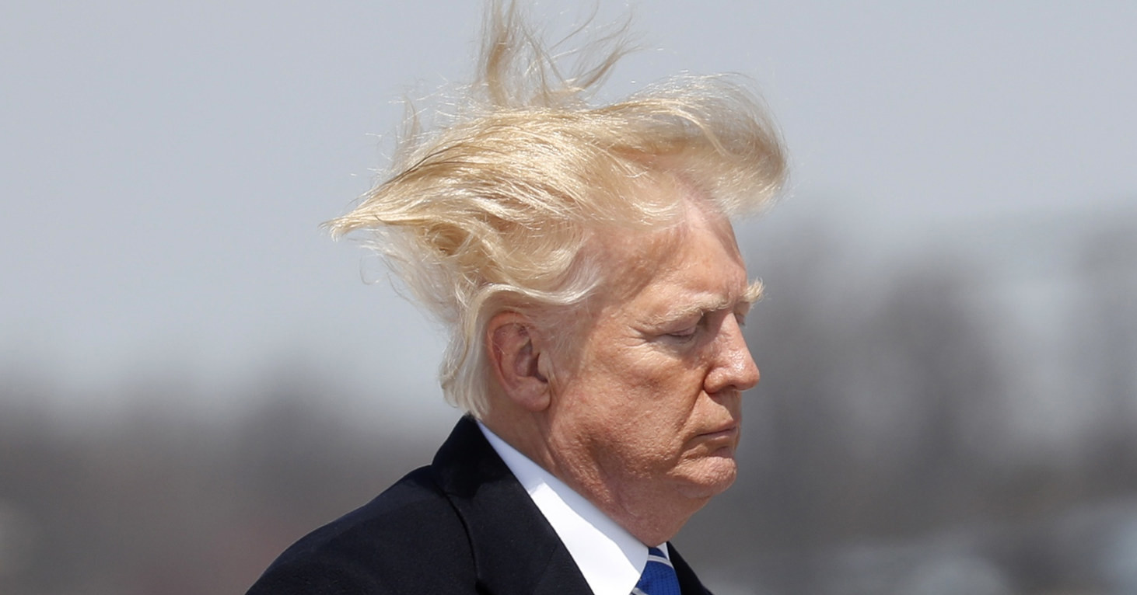
1. A Hair Raising Mistake
Firm took over responsibility for a CTM for hair products
Firm failed to notify OHIM
Revocation application sent to former attorneys
Forwarded to old address for client in Australia
Revocation application not defended and lost
Competitor took action against the client
Client forced to negotiate to recover its rights
PAMIA met some of the cost of acquiring trade marks

Slide 12

2. A Catalogue of Errors
Client wanted to launch new range of clothes for catalogue
Sought advice from firm on availability of trade mark
Insisted that advice was short and cheap
Firm obliged, advising “should be OK”
Firm did not advise about risks associated with a similar trade mark
Owner of similar trade mark took action following launch
Client decided to settle and pursued firm
PAMIA settled claim because risks not explained to client

Slide 13

3. A Desktop Calamity
Client wanted to launch a range of office furniture
Approached the firm for trade mark protection
Firm advised that marks were available
Firm instructed to file
Client ordered stock and launched products
Trade mark search report cited identical mark
Mark was in use, so client decided to change brand
PAMIA met associated costs

Slide 14
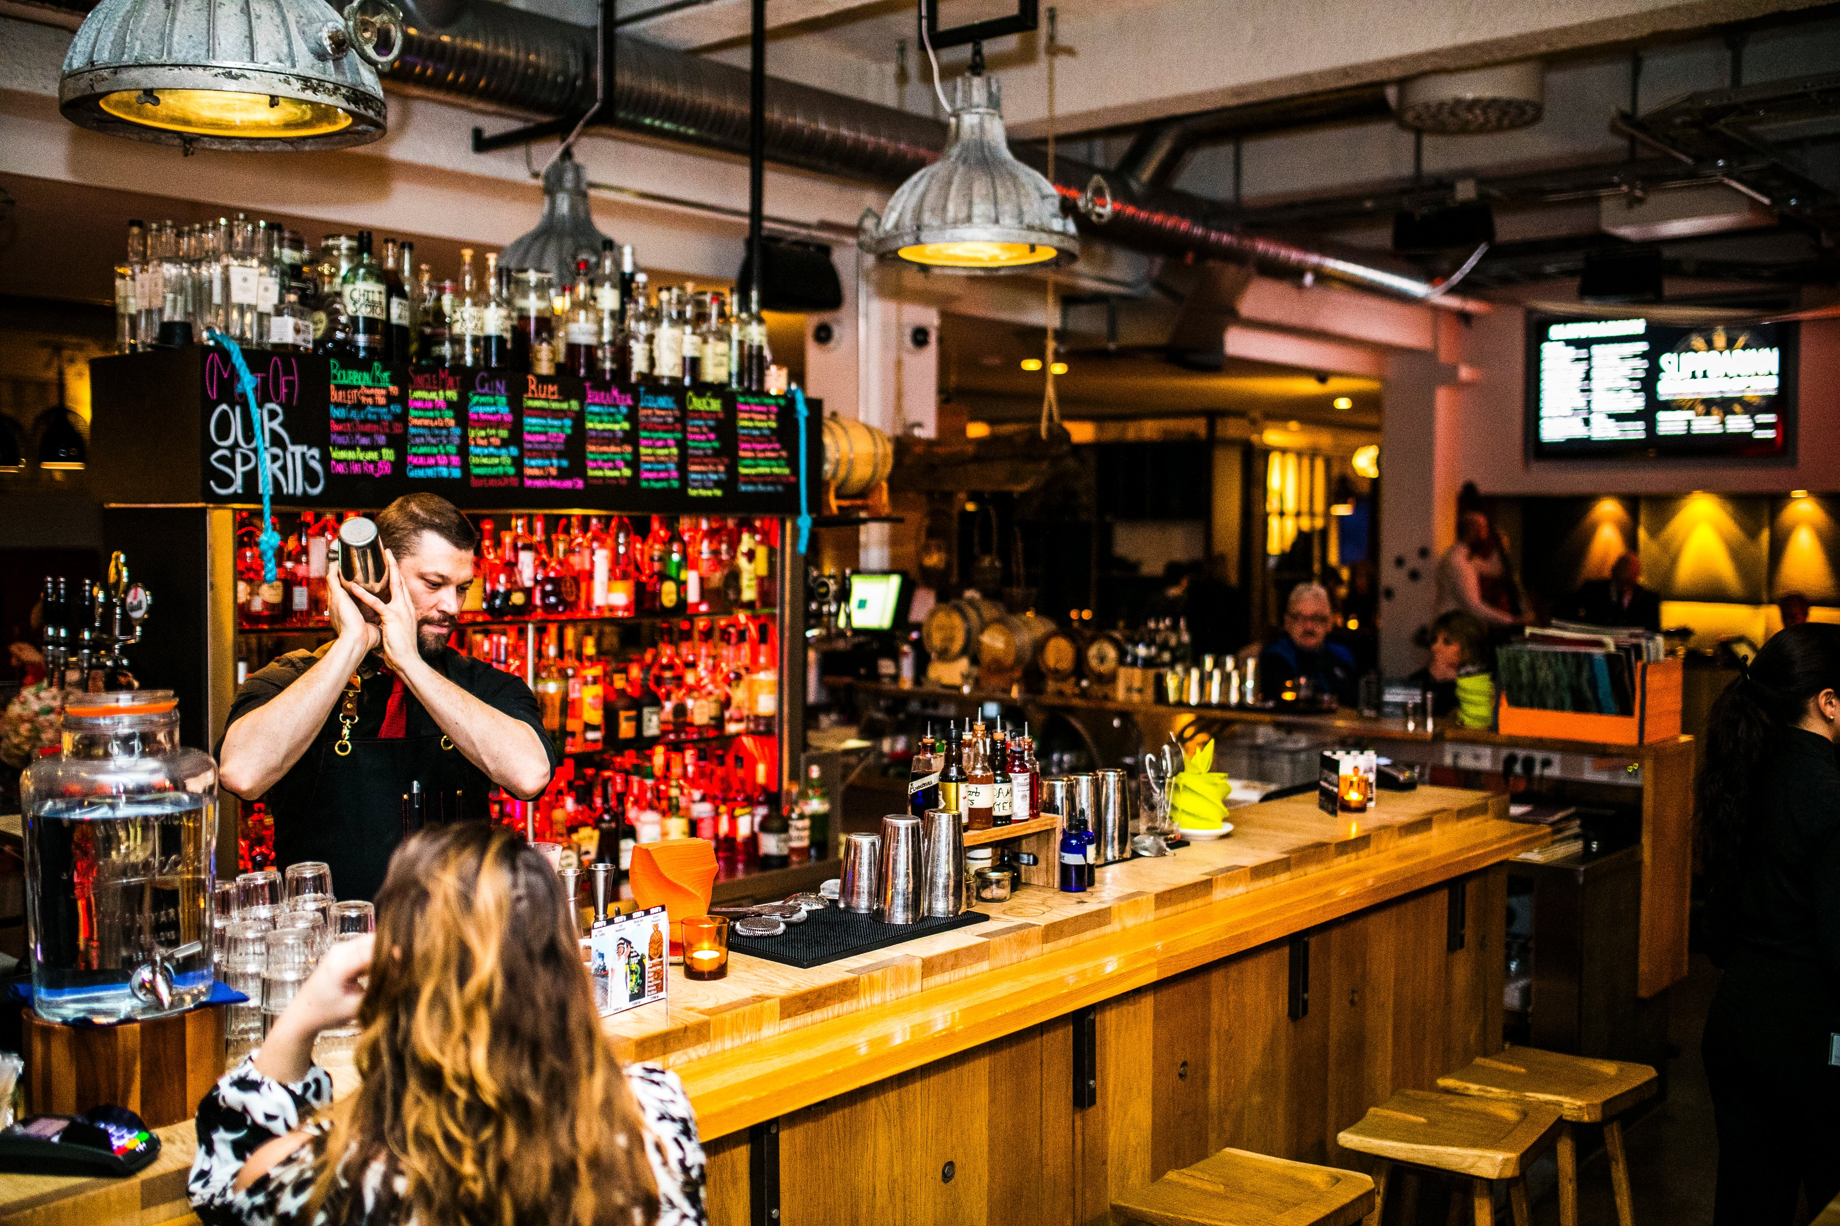
4. A Very Large Bar Bill
Client wanted to launch a new bar concept
Member advised that the mark was available
Member missed identical mark in identical class
Conflicting mark belonged to a large chain
Conflicting mark was not in use, but could not be cancelled
Client could not take the risk
Client shut down to re-brand
PAMIA paid business interruption costs

Slide 15
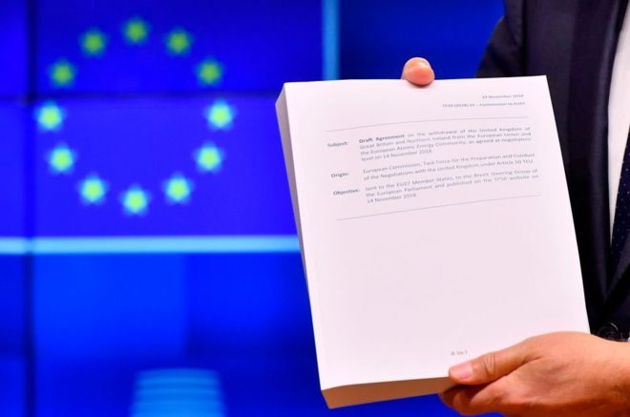
5. Not A Withdrawal Agreement
Member acting for client in trade mark opposition
By a settlement the opponent agreed to withdraw opposition
Technical assistant misunderstood agreement
Technical assistant drafted letter withdrawing client’s application
The responsible partner signed the letter
Client spent four years and a lot of money re-establishing its rights
PAMIA made a substantial contribution to the associated costs

Slide 16
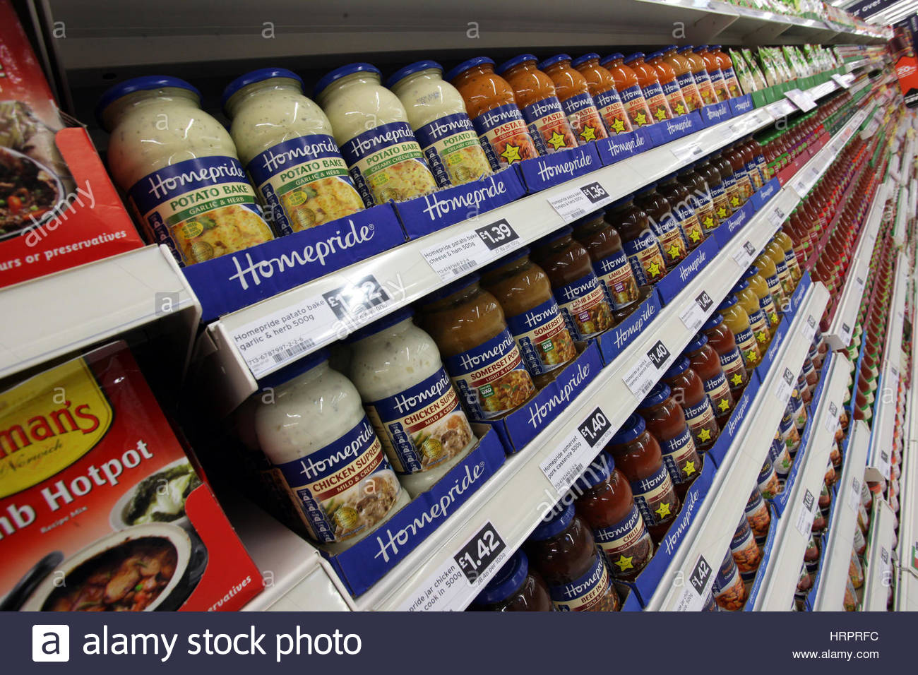
6. A Sauce of Inspiration
Client wanted to launch a new brand of sauces
Client was aware major manufacturer used a sequence of words to describe a similar product
The firm advised this sequence of words was not protected
Advice was based on a disclaimer in original trade mark
Advice overlooked separate mark for sequence of words
Major manufacturer took action and client settled
PAMIA contributed to the cost of settling

Slide 17
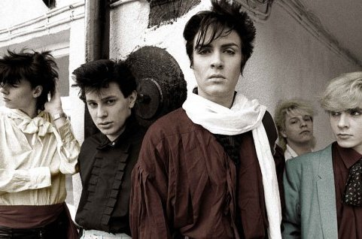
7. China Crisis
Firm was instructed to file an international registration designating China
Firm failed to tick box for China
A Chinese local filed a Chinese trade mark application for the client’s mark
The client’s plans to launch its high end product in China were thrown into disarray
Opposition was filed, but prospects were uncertain
PAMIA contributed to cost of purchasing local’s application

Slide 18
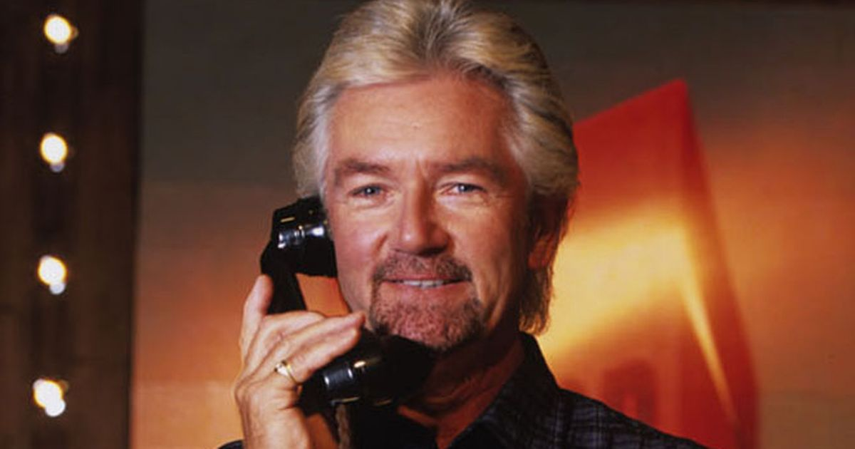
8. Deal Or No Deal
Firm acting for client in a trade mark dispute
Client instructed firm to accept a settlement offer
Firm failed to accept the offer
Other side withdrew the offer
Following protracted negotiations client had to settle on worse terms than previously available
PAMIA paid additional costs

Slide 19

Current Disputes
Case turning on whether the firm was instructed to file an application
Case turning on whether the client suffered any loss as a result of the firm failing to file an appeal in time against the refusal of a patent application
Case turning on whether a restoration application would have been successful if it had been filed in time
Case turning on whether the firm selected a competent overseas attorney to file an application

Slide 20

Risk Mitigation Tips
Do not succumb to cost cutting pressures
Do not allow clients to run up large debts
Make clients aware of the need for timely instructions
Avoid communication failures
Keep good records of instructions

Slide 21

Trends
Ombudsman complaints
Regulatory actions
Conflicts of interest

Slide 22


