Slide 1

Welcome to our London Lecture
Your speaker is:
Nick White, Charles Russell Speechlys
www.citma.org.uk

Slide 2
CITMA Lecture
17 July 2018
Sports Trade Marks: A Personal View
Nick White
nick.white@crsblaw.com

Slide 3
a bit of background

Slide 4
UK Causes of Action and Quasi-legal Redress
Trade Mark Infringement
Passing Off
Copyright
Marketing Codes:
- Non-Broadcast: The British Code of Advertising, Sales Promotion and Direct Marketing
- Broadcast: The BCAP Code

Slide 5
some important cases

Slide 6
Some Important Cases
Trade Mark infringement: Arsenal Football Club Plc v Matthew Reed Case C-206/01
Passing Off: Edmund Irvine v Talksport Ltd [2002] EWHC 367 (Ch)
Copyright: The Football Association Premier League & Others v Panini (UK) Limited [2002] EWHC 2779 (Ch)

Slide 7
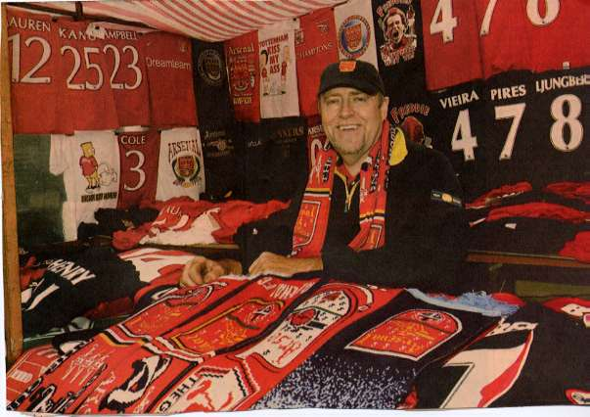
Arsenal Football Club Plc v
Matthew Reed Case C-206/01

Slide 8
Arsenal Football Club Plc v
Matthew Reed Case C-206/01
Matthew Reed had been selling Arsenal FC merchandise since 1970 including items displaying marks registered by the club.
Arsenal FC sued for passing off and trade mark infringement.
High Court asked ECJ: “does the third party have a defence to infringement on the ground that the use complained of does not indicate trade origin?”
ECJ: “Once it has been found that, in the present case, the use of the sign in question by the third party is liable to affect the guarantee of origin of the goods and that the trade mark proprietor must be able to prevent this, it is immaterial that in the context of that use the sign is perceived as a badge of support for or loyalty or affiliation to the proprietor of the mark.”

Slide 9
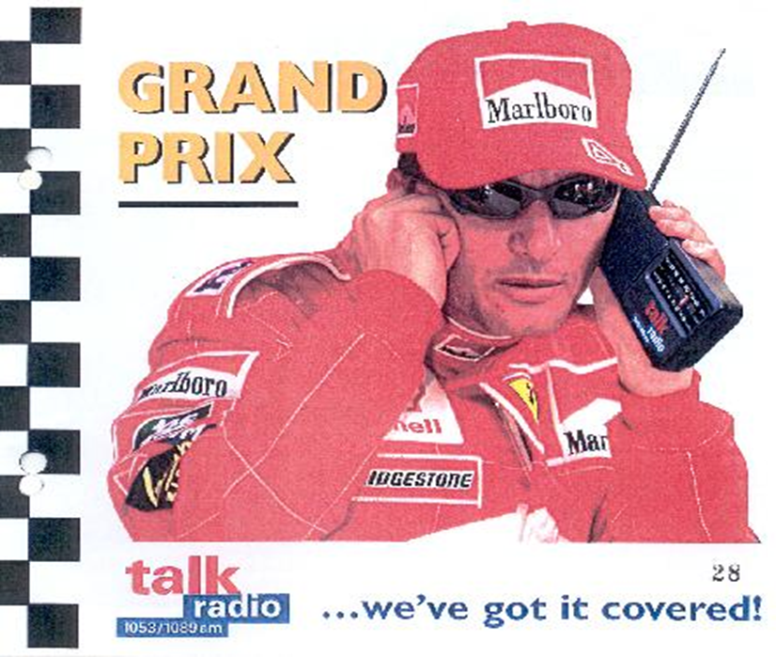
Edmund Irvine v Talksport Ltd
[2002] EWHC 367 (Ch)

Slide 10
Edmund Irvine v Talksport Ltd
[2002] EWHC 367 (Ch)
  Passing off by false suggestion of endorsement
  “Mr Irvine has a property right in his goodwill which he can protect from unlicensed appropriation consisting of a false claim or suggestion of endorsement of a third party’s goods or business.” Laddie J at first instance
  On appeal, awarded £25,000, even though limited circulation of the packs featuring the image (there were 981 recipients)

Slide 11
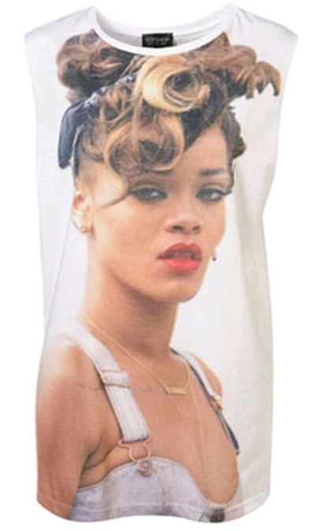
Passing Off: Rihanna v Topshop

Slide 12
Passing Off: Rihanna v Topshop
Fenty & Ors v Arcadia Group Brands Ltd (t/a Topshop) & Anor [2013] EWHC 2310 (Ch) (31 July 2013)
“I think the relationship between this image and the images of Rihanna for the album and the video shoot would be noticed by her fans. This is an important point. This image is not just recognisably Rihanna, it looks like a publicity shot for what was then a recent musical release. To someone who knew Rihanna but did not know her current work, the image is simply one of the person concerned. However, to her fans who knew her work, I think this particular image might well be thought to be part of the marketing campaign for that project.” Birss J
Judgment is part of gradual trend towards protecting the interests of celebrities. (Cf. privacy cases, e.g. Douglas v Hello!)

Slide 13
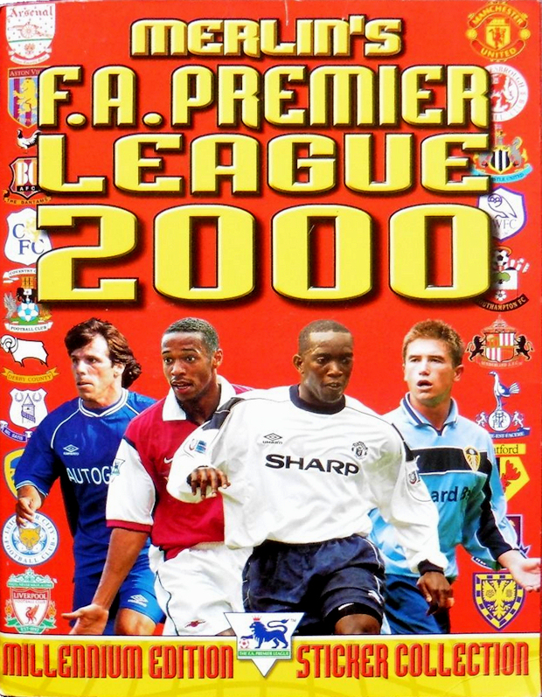
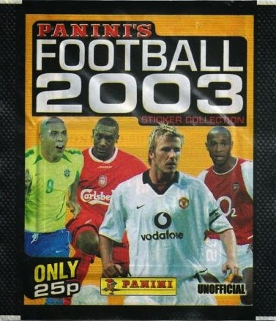
The Football Association Premier League & Others v Panini (UK) Limited [2002] EWHC 2779 (Ch)

Slide 14
The Football Association Premier League & Others v Panini (UK) Limited [2002] EWHC 2779 (Ch)
FAPL had an official sticker album deal with Topps/Merlin. Panini decided to produce their own unofficial stickers which included league and club logos on the players’ shirts.
Trade mark claim had been rejected in Trebor Bassett Ltd v The Football Association [1997] FSR 211. So, FAPL alleged copyright infringement in the badges and Panini argued the “incidental inclusion” defence.
FAPL succeeded, Peter Smith J holding that the badges were “an integral part of the artistic work comprised of the photograph of the professional footballer in his present-day kit.”

Slide 15
registering famous names

Slide 16
ALEX FERGUSON (UKIPO O-0946-06)
Accepted for a wide range of goods in classes 6, 9, 14, 16, 25, 28, 41
Rejected for “printed matter; posters; post cards, transfers; stickers; decalcomanias; stickers relating to football” (“Mere Image Carriers”)
The Appointed Person (Geoffrey Hobbs QC): “The more famous the personage(s) or event(s), the more likely it is that there will be a market for such goods and the less likely it is that the name will be regarded as acceptable for registration in relation to goods of that kind on the basis of the approach currently applied by the Registry in the United Kingdom.”

Slide 17
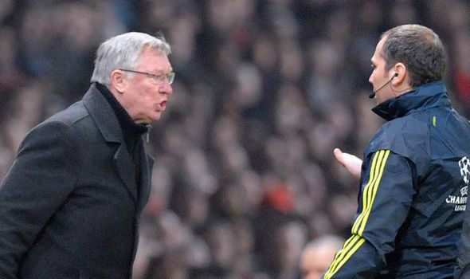
ALEX FERGUSON (O-0946-06)

Slide 18

MESSI Figurative Mark
In 2011 Lionel Messi applied for an EUTM
covering clothing and some other goods.
The application was opposed successfully by cycling brand Massi on the basis of their EUTM registration for MASSI covering clothing.
Messi appealed to the EUIPO and failed. He then appealed to the General Court and was successful.
On 26 April 2018, the General Court held the EUIPO had been, “wrong to consider that the reputation enjoyed by Mr Messi concerns only the part of the public which is interested in football and sport in general. Mr Messi is, in fact, a well-known public figure who can be seen on television and who is regularly discussed on television or on the radio.”

Slide 19
Good to be famous then, or not?
Sir Alex’s fame worked against him (absolute grounds – UKIPO), Lionel Messi’s worked in his favour (relative grounds – EUIPO).
We successfully had WAYNE ROONEY, ANTHONY JOSHUA and MO FARAH all registered as EU trade marks, including for photos, posters etc.
EUIPO practice is different to UKIPO:
“names of persons are distinctive (see judgment of 16 September 2004, C-4-4/02, “Nichols”) and the office does not object even to trade marks consisting of names of famous people” ATATURK, Decision of Cancellation Division, 28 October 2011

Slide 20
ambushing and image rights

Slide 21
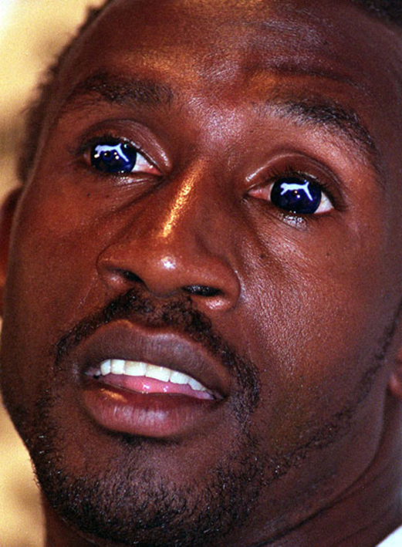
Olympic Games: Atlanta 1996
This sort of activity led to changes in athlete terms of participation at major events, e.g.:
“I agree not the wear any item of clothing or kit bearing any name, logo or design of any commercial entity, or to have tattooed, branded, shaved, cut, pierced, applied or fixed to, into or onto my body (including but not limited to, onto or into my hair and/or nails or onto my spectacles or contact lenses) any name, logo or design of any commercial or other entity, save as permitted under the Terms of Participation.”
(Rugby World Cup Participation Agreement 2003)

Slide 22
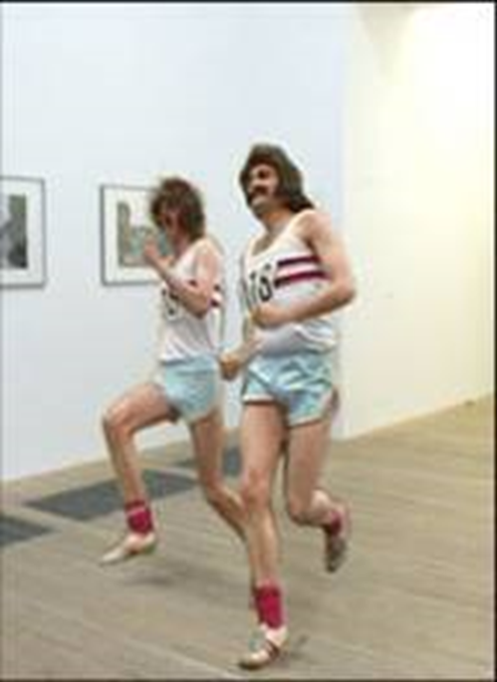
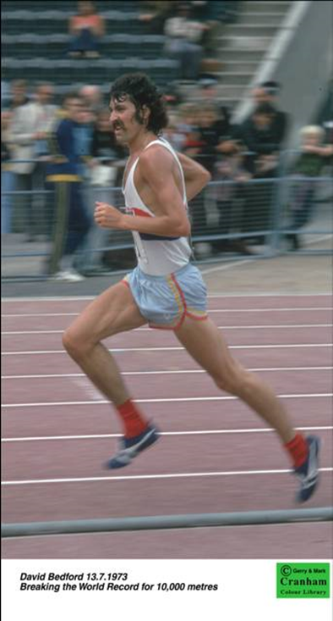
The Number (118 118) / David Bedford 2003
“With limited exceptions, living persons must not be featured, caricatured or referred to in advertisements without their permission.” BCAP Code, Section 6.1

Slide 23
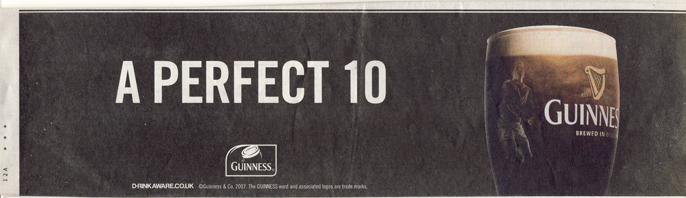
Six Nations 2007 / Jonny Wilkinson

Slide 24
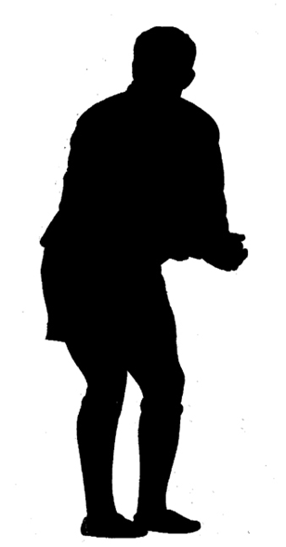
Six Nations 2007 / Jonny Wilkinson
Registered CTM 3592458

Slide 25
event specific legislation

Slide 26
Event Specific Legislation
London Olympic & Paralympic Games Act 2006
“There shall be a right, to be known as the London Olympics association right, which shall confer exclusive rights in relation to the use of any representation (of any kind) in a manner likely to suggest to the public that there is an association between the London Olympics and—
  (a) goods or services, or
  (b) a person who provides goods or services.”
  (Schedule 4: The London Olympics Association Right)
Russia FIFA World Cup 2018: Federal Law of June 7, 2013 No. 108-FZ: Similar provisions banning the suggestion of association with FIFA or the World Cup

Slide 27
London Olympics Association Right:
“Combination of Expressions”
“(1) For the purpose of considering whether a person has infringed the London Olympics association right a court may, in particular, take account of his use of a combination of expressions of a kind specified in sub-paragraph (2).
(2)The combinations referred to in sub-paragraph (1) are combinations of—
(a) any of the expressions in the first group, with
(b) any of the expressions in the second group or any of the other expressions in the first group.”
First group: “games”, “Two Thousand and Twelve”, “2012” and “twenty twelve”
Second group: “gold”, “silver”, “bronze”, “London”, “medals”, “sponsor”, and “summer”.

Slide 28
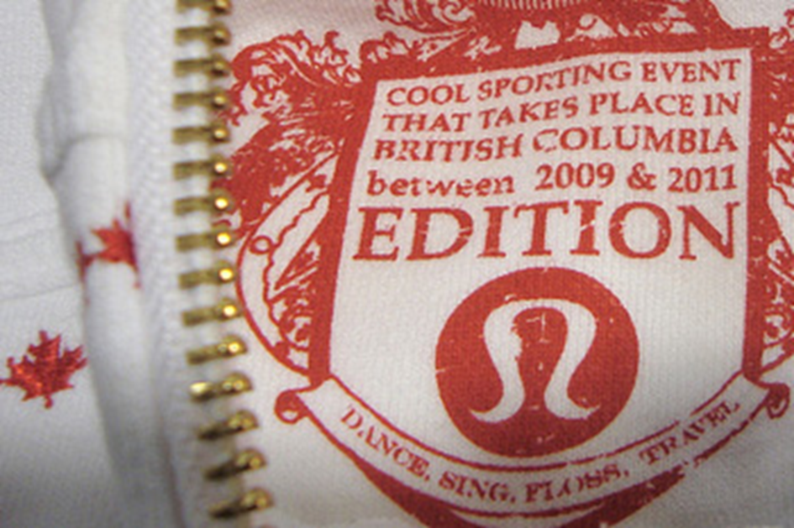
Winter Olympic Games: Vancouver 2010
Lululemon
“We expected better sportsmanship from a local Canadian company than to produce a clothing line that attempts to profit the Games but doesn’t support the Games or the success of the Canadian Olympic team” (Bill Cooper, Vanco’s director or commercial rights management)

Slide 29
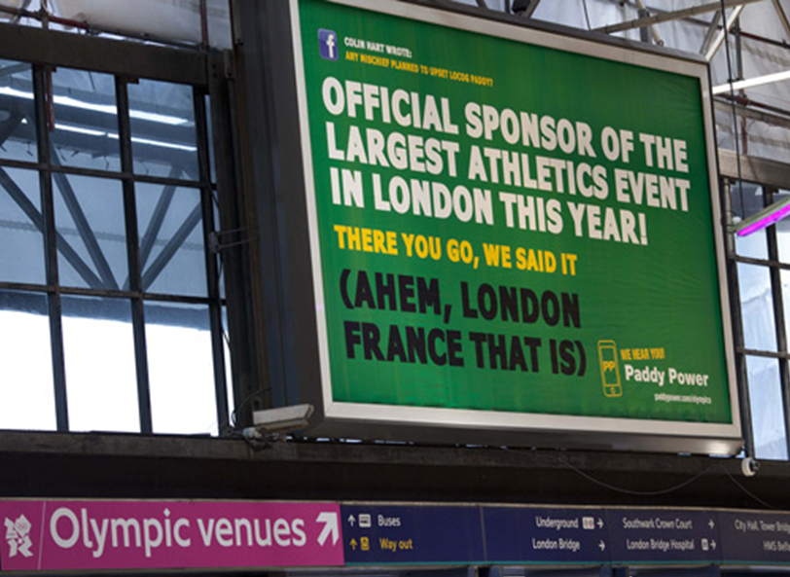

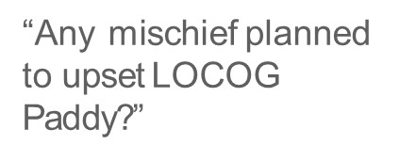
Olympic Games: London 2012
LOCOG ordered JCDecaux to take the posters down
Paddy Power threatened to seek a declaration of non-infringement
LOCOG decided to allow the campaign to run

Slide 30
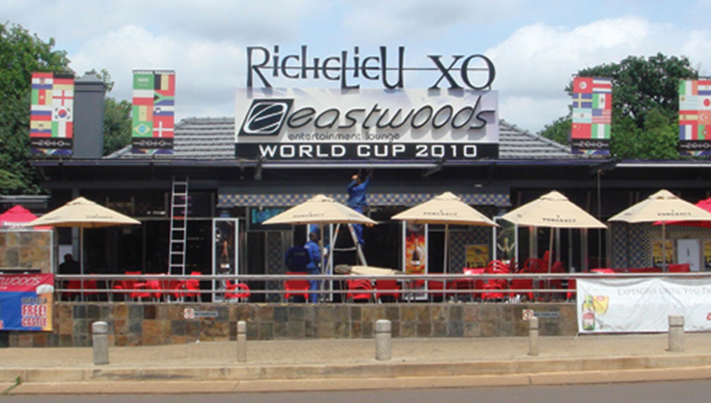
FIFA World Cup: South Africa 2010
FIFA v Eastwood Tavern, High Court of South Africa (Gautenm North Pretoria), 14 May 2009
Injunction granted preventing Eastwood Tavern from using WORLD CUP 2010, SOUTH AFRICA 2010 and TWENTY TEN SOUTH AFRICA in relation to restaurant or entertainment services and/or from competing unlawfully with FIFA by obtaining special promotional benefit from or associating its business with the 2010 FIFA World Cup in contravention of s15A of the Merchandise Marks Act 1941 (as amended).

Slide 31
thanks for listening

